Slide 1
Gene Prediction:
Similarity-Based Approaches
(selected from Jones/Pevzner lecture notes)

Slide 2
Using Known Genes to Predict New Genes
Some genomes may be very well-studied, with many genes having been experimentally verified.
Closely-related organisms may have similar genes
Unknown genes in one species may be compared to genes in some closely-related species

Slide 3
Similarity-Based Approach to Gene Prediction
Genes in different organisms are similar
The similarity-based approach uses known genes in one genome to predict (unknown) genes in another genome
Problem: Given a known gene and an unannotated genome sequence, find a set of substrings of the genomic sequence whose concatenation best fits the gene

Slide 4
Comparing Genes in Two Genomes
Small islands of similarity corresponding to similarities between exons

Slide 5
Comparing Genomic DNA Against mRNA
mRNA
(codon sequence)
{
{
{
{
{
exon1
intron1
exon2
intron2
exon3
Portion of genome

Slide 6
Using Similarities to Find the Exon Structure
The known frog gene is aligned to different locations in the human genome
Find the “best” path to reveal the exon structure of human gene
Frog Gene (known)
Human Genome

Slide 7
Finding Local Alignments
Use local alignments to find all islands of similarity
Frog Genes (known)
Human Genome

Slide 8
Chaining Local Alignments
Find substrings that match a given gene sequence (candidate exons)
Define a candidate exons as
(l, r, w)
(left, right, weight defined as score of local alignment)
Look for a maximum chain of substrings
  Chain: a set of non-overlapping nonadjacent intervals.

Slide 9
Exon Chaining Problem
5
5
15
9
11
4
3
0
2
3
5
6
11
13
16
20
25
27
28
30
32
Locate the beginning and end of each interval (2n points)
Find the “best” path

Slide 10
Exon Chaining Problem: Formulation
Exon Chaining Problem: Given a set of putative exons, find a maximum set of non-overlapping putative exons
Input: a set of weighted intervals (putative exons)
Output: A maximum chain of intervals from this set

Slide 11
Exon Chaining Problem: Formulation
Exon Chaining Problem: Given a set of putative exons, find a maximum set of non-overlapping putative exons
Input: a set of weighted intervals (putative exons)
Output: A maximum chain of intervals from this set
Would a greedy algorithm solve this problem?

Slide 12
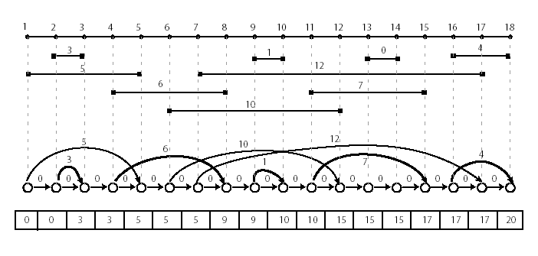
Exon Chaining Problem: Graph Representation
This problem can be solved with dynamic programming in O(n) time.

Slide 13
Exon Chaining Algorithm
ExonChaining (G, n) //Graph, number of intervals
for i ← to 2n
s_{i} ← 0
for i ← 1 to 2n
if vertex v_{i} in G corresponds to right end of the interval I
j ← index of vertex for left end of the interval I
w ← weight of the interval I
s_{j} ← max {s_{j} + w, s_{i-1}}
else
s_{i} ← s_{i-1}
return s_{2n}

Slide 14
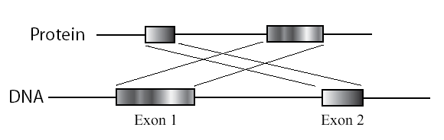
Exon Chaining: Deficiencies
  Poor definition of the putative exon endpoints
  Optimal chain of intervals may not correspond to any valid alignment
    First interval may correspond to a suffix, whereas second interval may correspond to a prefix
    Combination of such intervals is not a valid alignment

